Slide 1
DS 598 Introduction to RL
Xuezhou Zhang

Slide 2
Announcements
Homework 1 is out. Due by the end of next week. Any questions?
Course project details will be released next week.
Pytorch tutorial + project environment installation Helpdesk in the discussion section next week.

Slide 3
Recap: Planning
Value Iteration and Policy Iteration.
Linear Programming with Occupancy Measures.
None of these methods work directly for high-dimension/complicated MDPs 🥲 🥲 🥲
In practice, people often apply some vanilla RL algorithms instead, which means a big room of improvement!

Slide 4
Chapter 3: Model-based RL

Slide 5
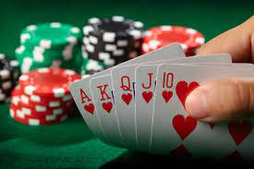
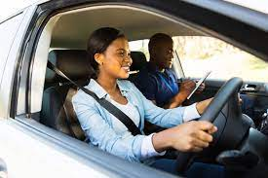

Online Reinforcement Learning
Start by knowing nothing about the environment.
Gather information while interacting with the environment.
Gather reward / suffer costs along the way.

Slide 6
Online Reinforcement Learning
The grand goal of RL/AGI is to design the learning agent, not the learned policy.

Slide 7
What is model-based RL (MBRL)?
Step 1: Learn an estimated MDP using existing data.
Step 2: Do planning in the learned MDP (simulator).
Step 3: Try the new policy out in the real world.
Go to Step 1 after collecting more data.

Slide 8
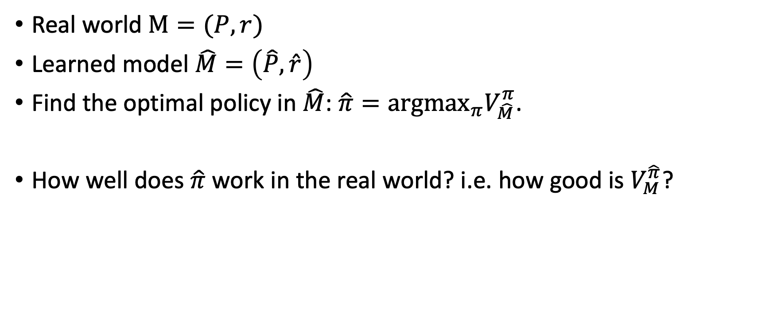
Why can MBRL work at all?
Real world $M=(P,r)$
Learned model $\hat{M}=\left(\hat{P},\hat{r}\right)$
Find the optimal policy in $\hat{M}$: $\hat{π}={{argmax}_{π}V}_{\hat{M}}^{π}$.
How well does $\hat{π}$ work in the real world? i.e. how good is $V_{M}^{\hat{π}}$?

Slide 9
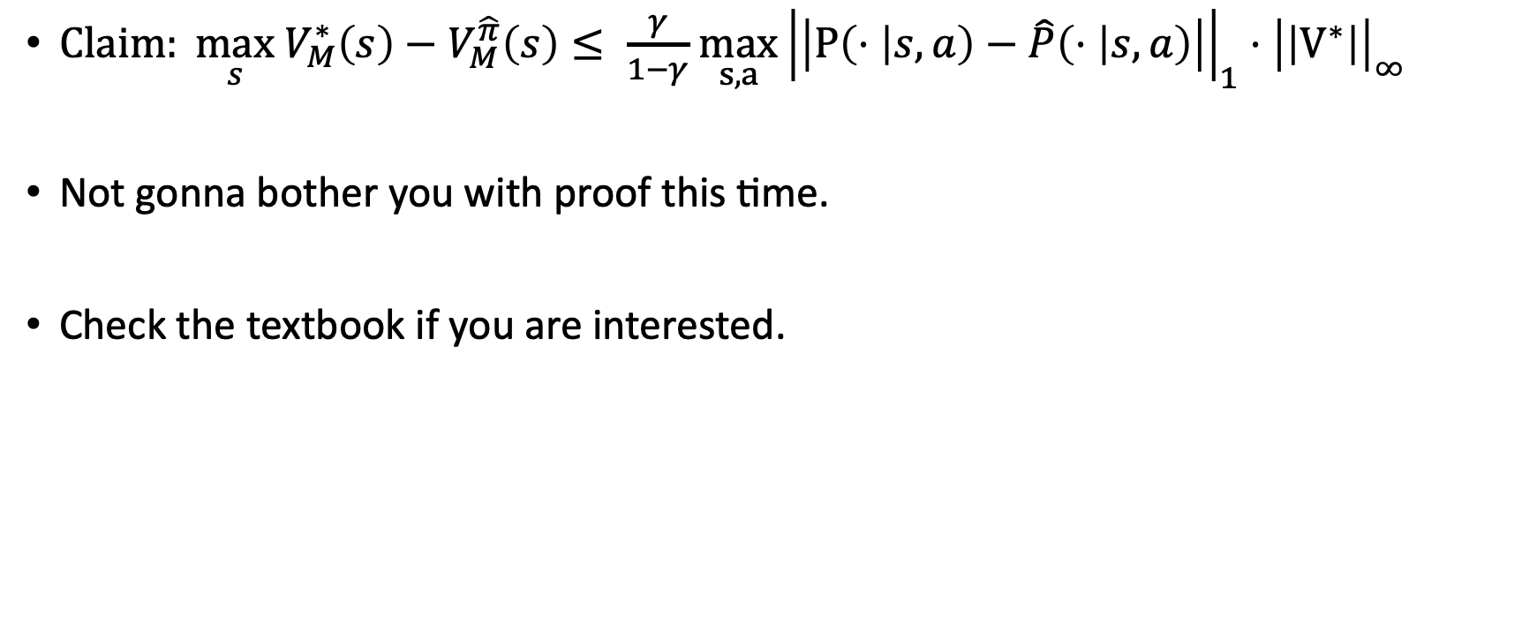
Simulation Lemma
$Claim: {\max_{s} V}_{M}^{∗}\left(s\right)−V_{M}^{\hat{π}}\left(s\right)≤ \frac{γ}{1−γ}$ $\max_{s,a}{\left|\left|P\left(⋅ | s,a\right)−\hat{P}\left(⋅ | s,a\right)\right|\right|}_{1}{⋅\left|\left|V^{∗}\right|\right|}_{∞}$
Not gonna bother you with proof this time.
Check the textbook if you are interested.

Slide 10
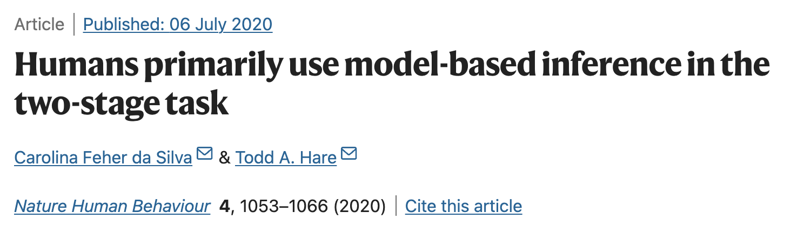

Are Humans model-based learners?

Slide 11

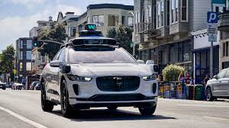
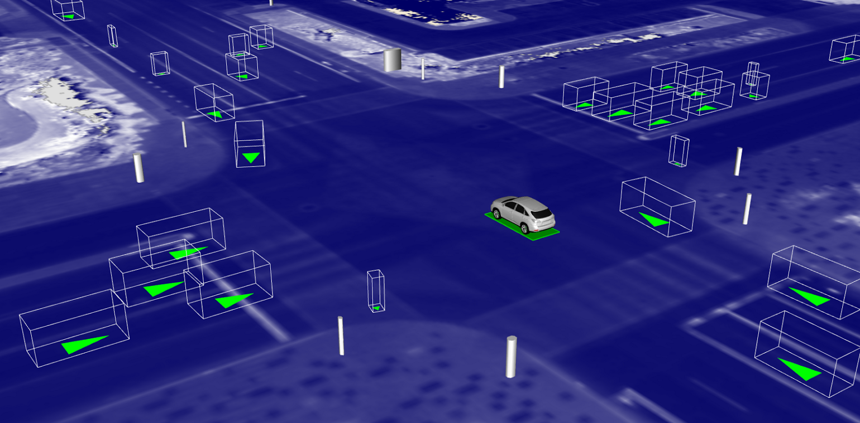
Autonomous Driving is model-based.
Test on the road and collect data
Build and Train inside a Simulator

Slide 12
Does it work in practice?
To some extent, yes.
Heavily used in robotics.
a.k.a. Model Predictive Control (MPC)

Slide 13
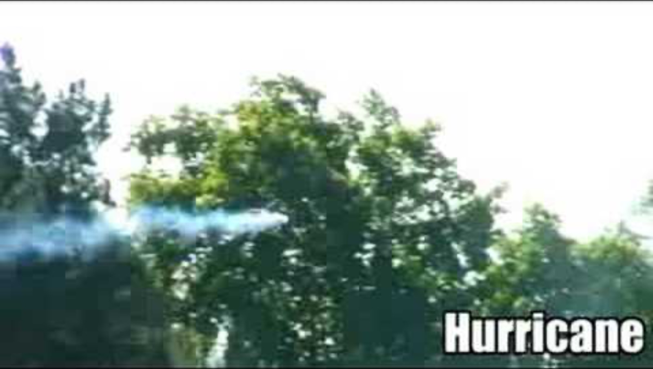
http://heli.stanford.edu 2008 Video

Slide 14
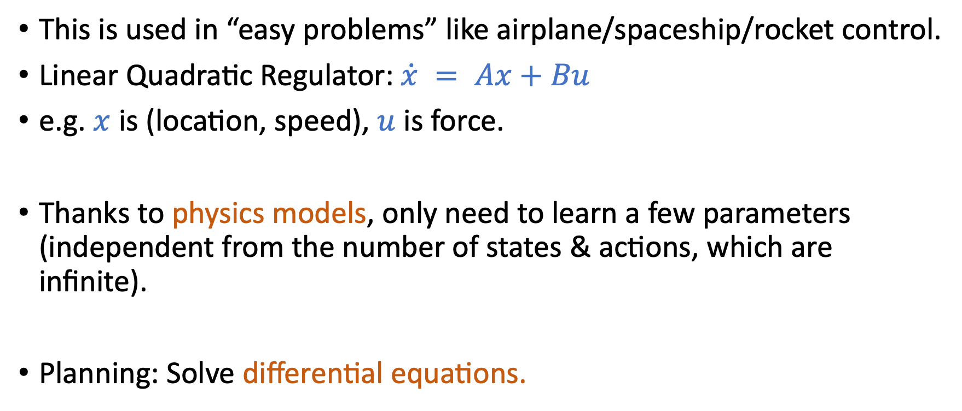
Model Predictive Control (MPC)
This is used in “easy problems” like airplane/spaceship/rocket control.
Linear Quadratic Regulator: $\dot{x} = Ax+Bu$
e.g. $x$ is (location, speed), $u$ is force.
Thanks to physics models, only need to learn a few parameters (independent from the number of states & actions, which are infinite).
Planning: Solve differential equations.

Slide 15
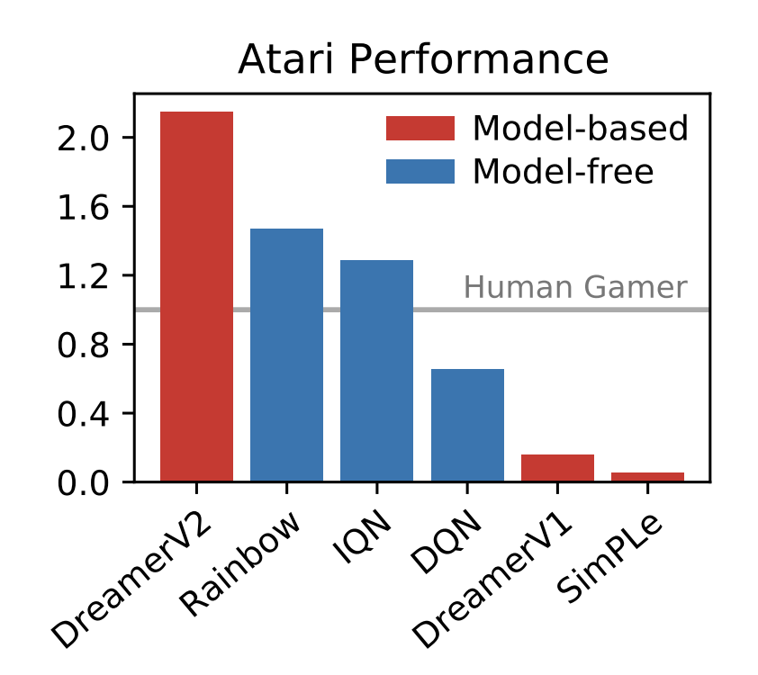
Does it work?
In other settings, model-based RL have been under-performing until very recently.
DQN: 2013
DreamerV2: 2021

Slide 16
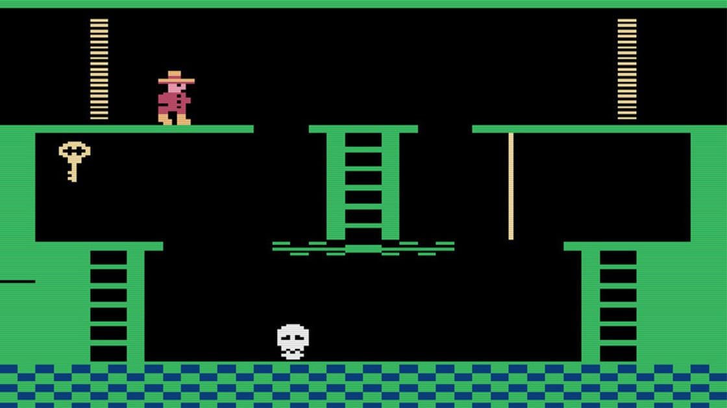
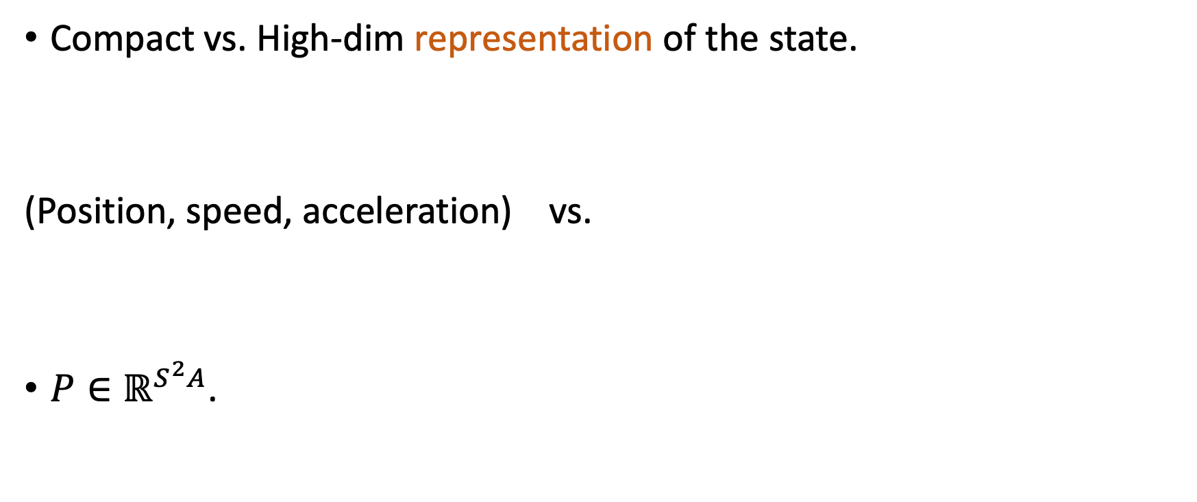
Why does it work in robotics but not Atari Games
Compact vs. High-dim representation of the state.
(Position, speed, acceleration) vs.
$P∈ℝ^{S^{2}A}$.

Slide 17
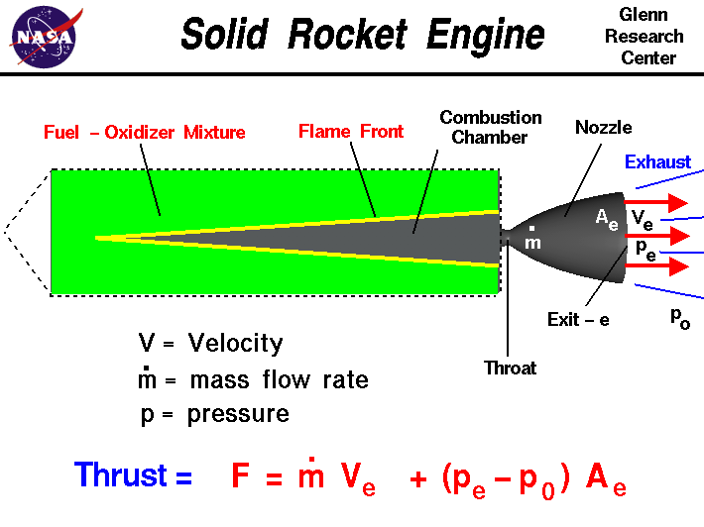
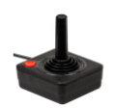
Why does it work in robotics but not Atari Games
Strong prior knowledge on the physical model.
# data needed scales polynomially with # of parameters
vs. P( | , )

Slide 18
Summary of Challenges with MBRL
Transition model with high-dim observation is hard to learn.
How to plan in the learned model?
How to effectively encode domain knowledge?
(This is a mega challenge for all of ML)

Slide 19
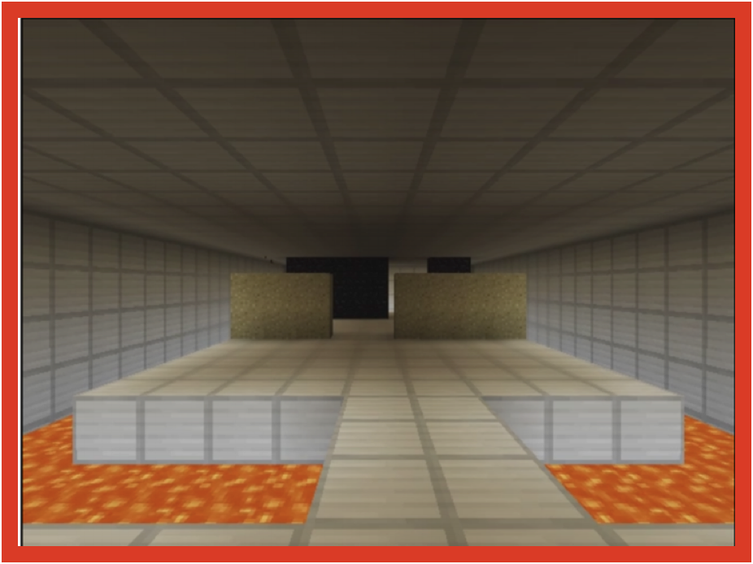
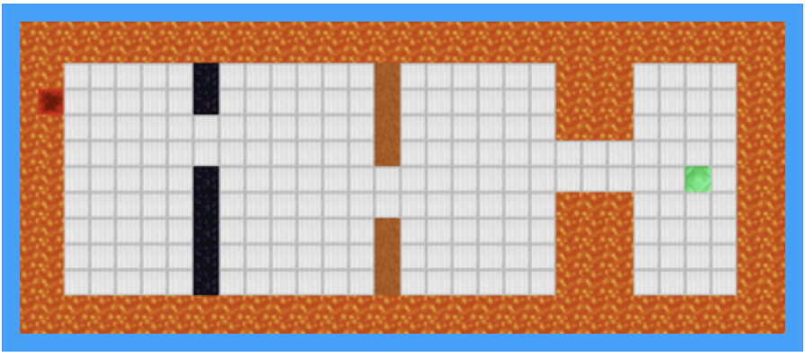
DreamerV2 [Hafner et al. 2021]
Idea: learning a latent world model with discrete states.
vs.
low-dim latent state
high-dim observation

Slide 20
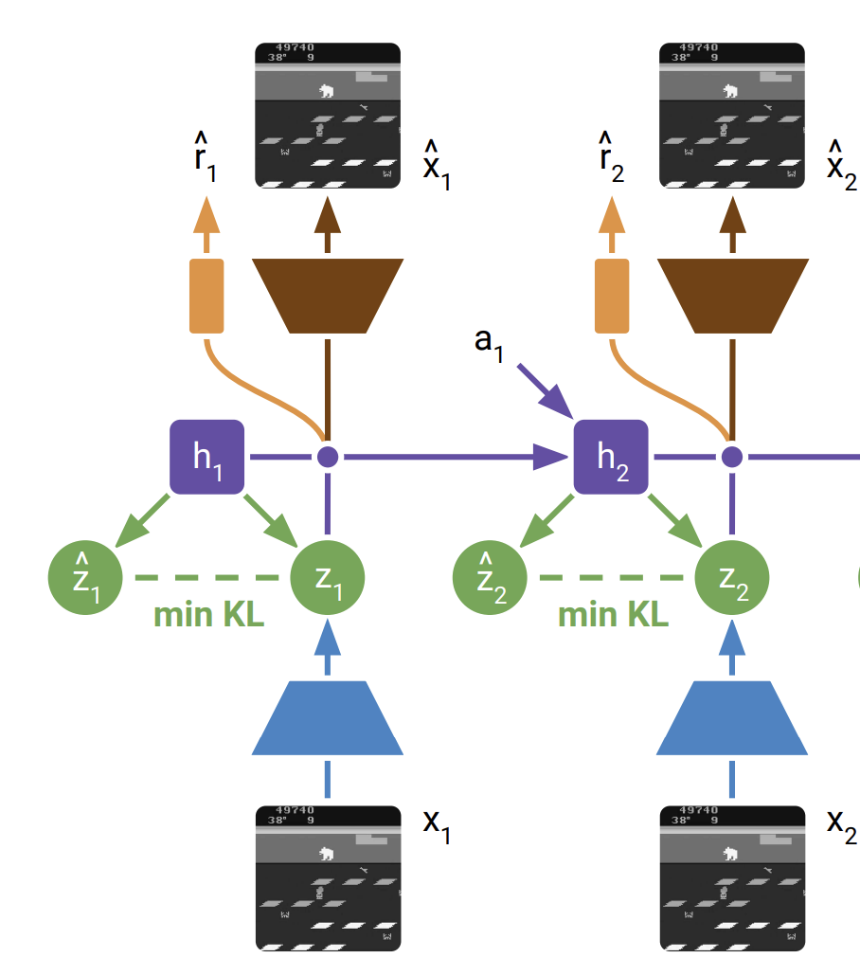
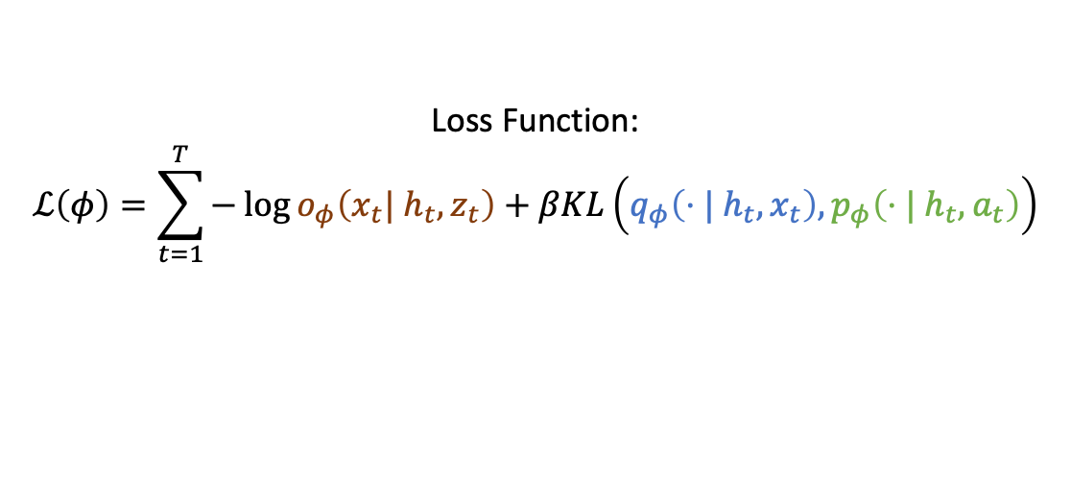
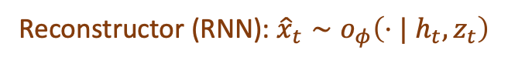
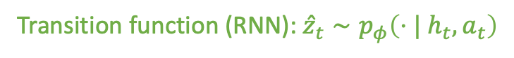
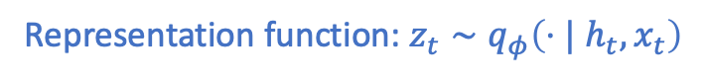
DreamerV2 [Hafner et al. 2021]
Loss Function:
$$ℒ\left(φ\right)=\sum_{t=1}^{T}{−\log{o_{φ}\left(x_{t}| h_{t},z_{t}\right)}+βKL\left(q_{φ}\left(⋅| h_{t},x_{t}\right), p_{φ}\left({⋅| h}_{t},a_{t}\right)\right)}$$
DreamerV2 world model:
Reconstructor (RNN): ${\hat{x}}_{t}∼o_{φ}\left(⋅| h_{t},z_{t}\right)$
Recurrent Module (RNN): $h_{t}=f_{φ}\left(h_{t−1},z_{t−1},a_{t−1}\right)$
Transition function (RNN): ${\hat{z}}_{t}∼p_{φ}\left({⋅| h}_{t},a_{t}\right)$
Representation function: $z_{t}∼q_{φ}\left(⋅| h_{t},x_{t}\right)$

Slide 21
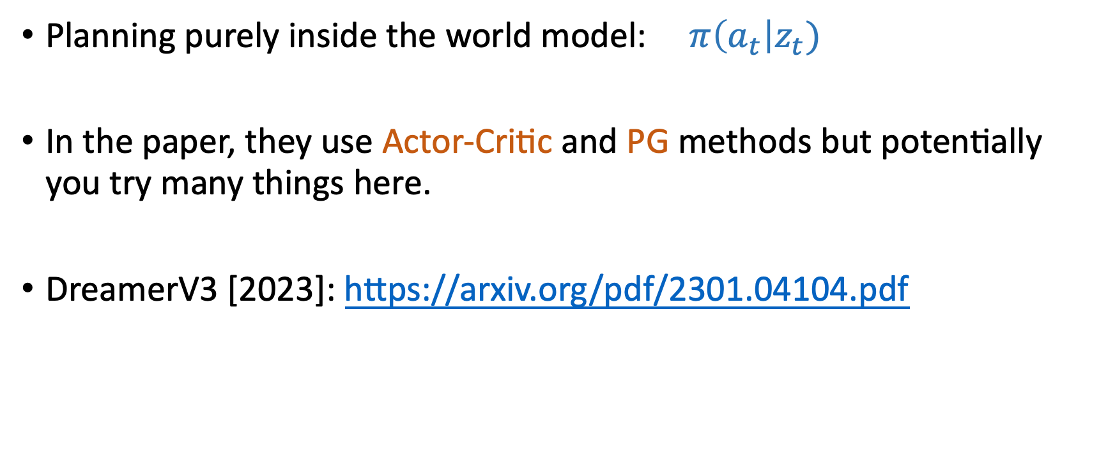
DreamerV2 [Hafner et al. 2021]
Planning purely inside the world model: $π\left(a_{t}\right|z_{t})$
In the paper, they use Actor-Critic and PG methods but potentially you try many things here.
DreamerV3 [2023]: https://arxiv.org/pdf/2301.04104.pdf

Slide 22
DreamerV2 [Hafner et al. 2021]
Summary of DreamerV2:
Learn Latent world model with discrete latent states and image recovery.
Plan in the latent world model with some RL algorithms.

Slide 23

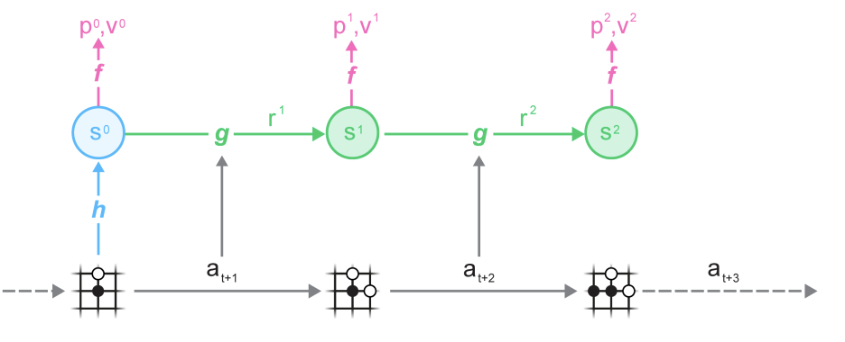
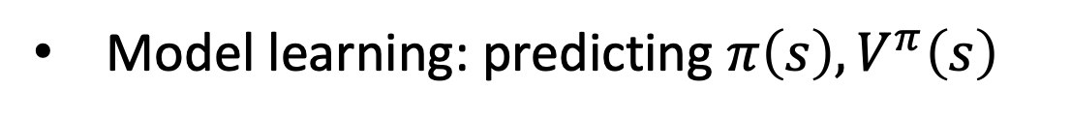
MuZero [Schrittwieser et al. 2020]
h = representation function
f = prediction function
g = transition function
Model learning: predicting $π\left(s\right), V^{π}\left(s\right)$

Slide 24
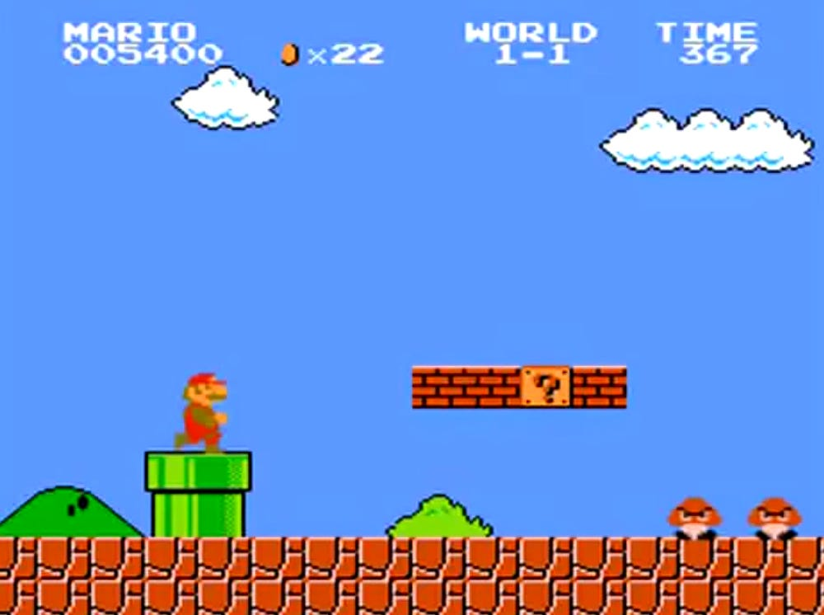
Recover the pixel observation or not?

Slide 25
Recover the pixel observation or not?
A minimal representation

Slide 26
Recover the pixel observation or not?
A minimal representation
Representation required to recover the pixels
(redundant information)

Slide 27
Recover the pixel observation or not?
Pros:
generalize well across tasks.
Cons:
more redundant representation.
Harder to train.

Slide 28
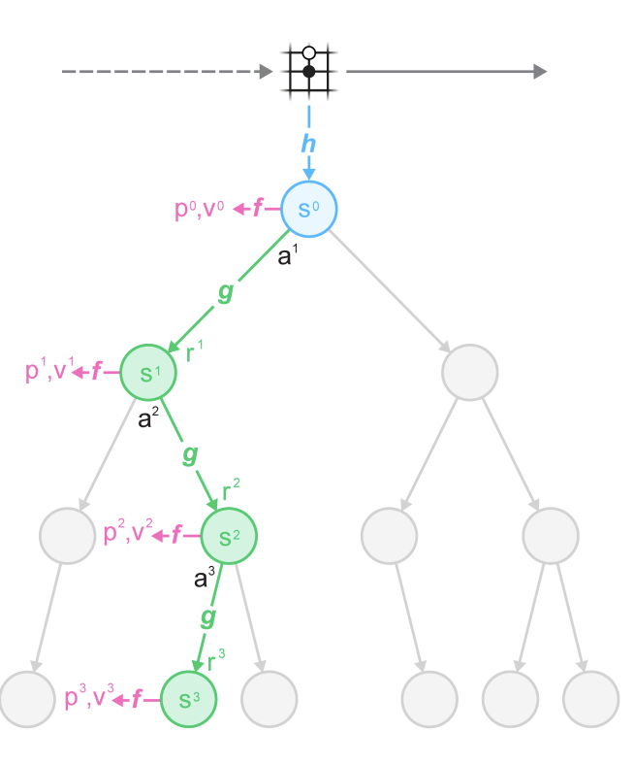
MuZero [Schrittwieser et al. 2020]
Planning via Monte Carlo Tree Search (MCTS)
Vanilla MCTS only works for deterministic transition.
Variants exist that handles stochastic transitions.

Slide 29
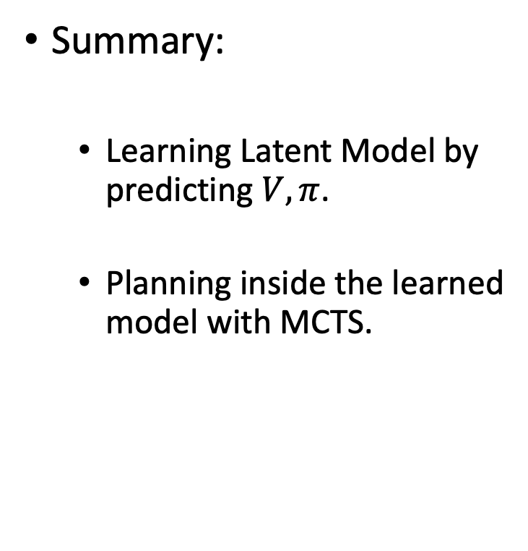
MuZero [Schrittwieser et al. 2020]
Summary:
Learning Latent Model by predicting $V,π$.
Planning inside the learned model with MCTS.

